Slide 1
Chapter 12: Database Managers on z/OS

Slide 2
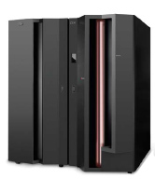
Chapter objectives
Be able to:
Explain how databases are used in a typical online business.
Describe two models for network connectivity for large systems.
List common DB2 data structures.
Compose simple SQL queries to run on z/OS.
Give an overview of application programming with DB2.
Describe the IMS DB components
List common IMS DB structures

Slide 3
Key terms in this chapter
bind
DBMS
EXPLAIN
modified source
database
DBMS
root
segment
SPUFI
SQL
SYSADM
view

Slide 4
What is a database?
A database provides for the storing and control of business information, independent from (but not separate from the processing requirements of) one or more applications.
Screenshot 1

Slide 5
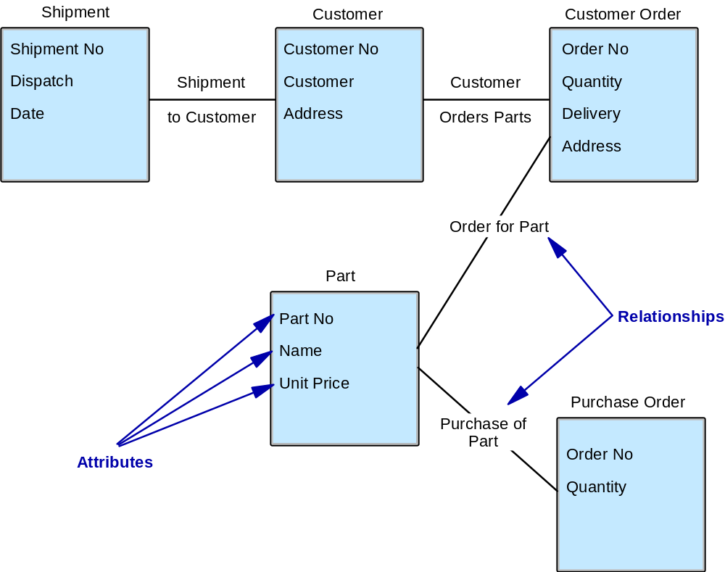
Database example
Entities
Attributes
Relationships
entity
Note: An attribute is always dependent on
an entity – it has no meaning by itself
one-to-one
one-to-many
many-to-many
{
Note: Relationships can
be recursive

Slide 6
Why use a database?
Reduce programming effort
Manage data more efficiently
Easy to separate confidential/sensitive info
Provide a greater level of security
Access & update simultaneously
Ensure consistency
Provide backup and recovery
Utilities to monitor and tune
Structure change does not impact existing developments

Slide 7
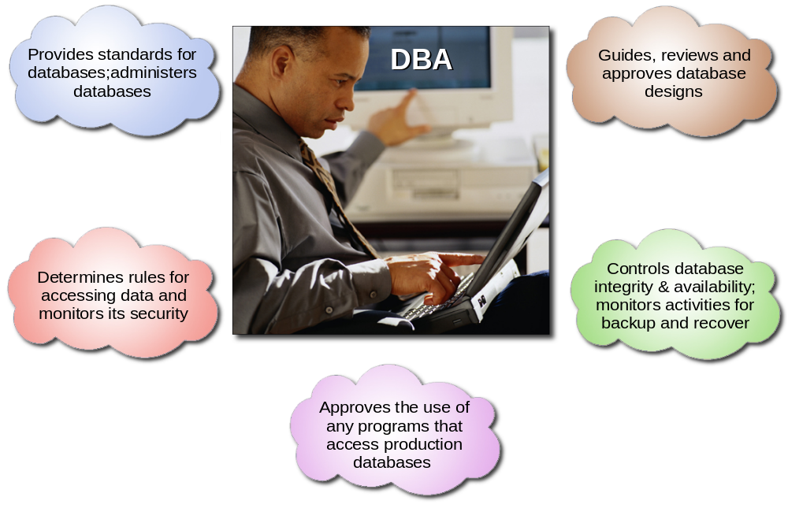
Role of the database administrator

Slide 8
Databases: terminology
Entities
Data attributes
Entity relationships
Application functions
Access paths

Slide 9
Databases on z/OS
Hierarchical databases, such as IMS
Relational database management system (RDBMS), such as DB2

Slide 10
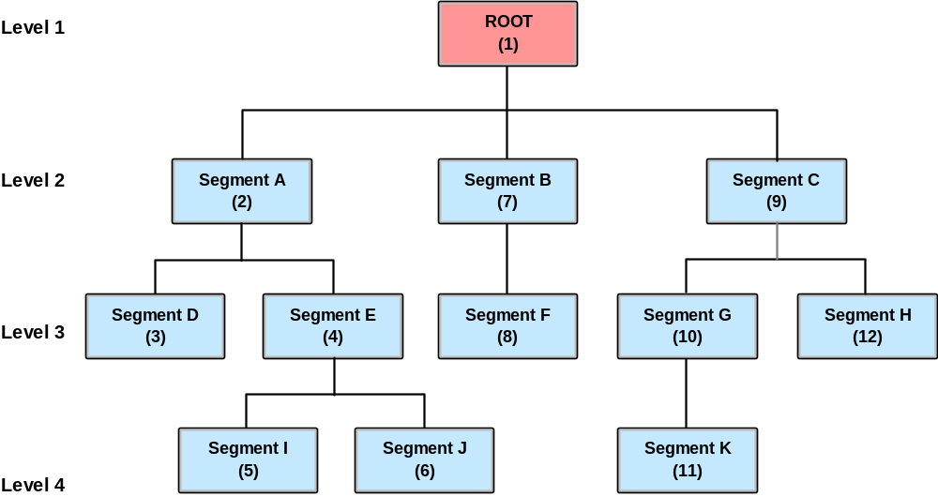
Hierarchical DB : Relationships & sequence

Slide 11
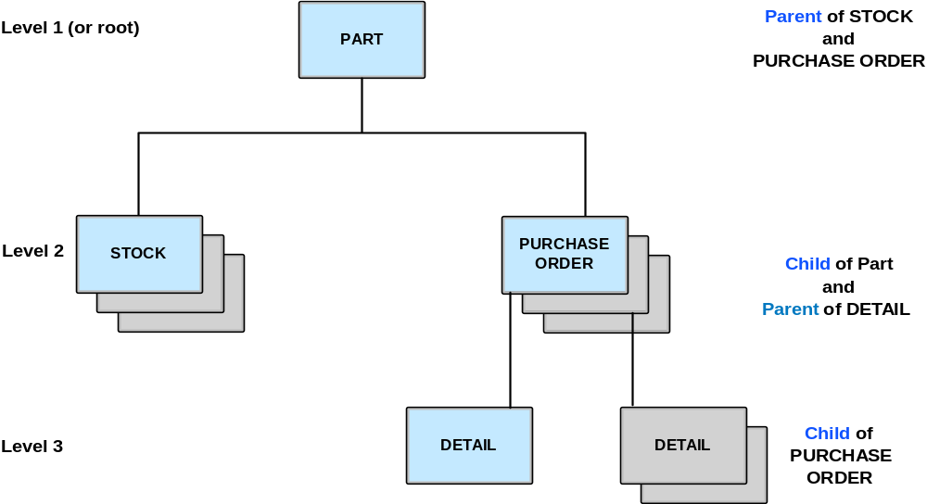
Hierarchical data structure

Slide 12
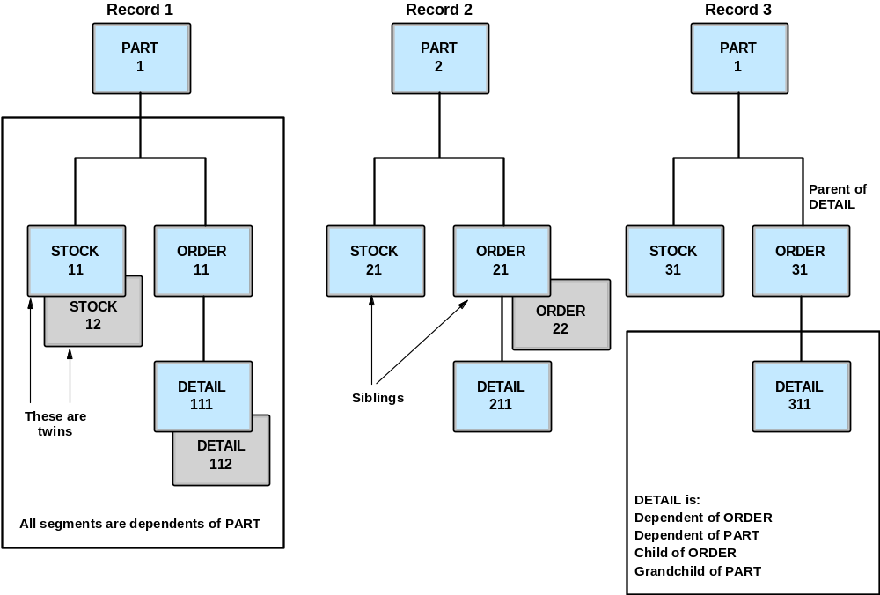
Segment types and their relationships

Slide 13
DB2 – The Relational Database
Relational Structures include:
Database: A logical grouping of data for one or more
applications
Table: A logical structure composed of rows and
columns
Index(es): an ordered set of pointers to rows of a table (ensures uniqueness)
Keys: One or more columns that are identified as such in the creation of a table or used for referential integrity

Slide 14
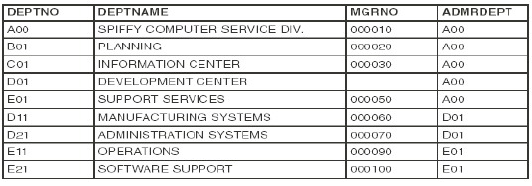
Example of a DB2 Department Table i.e. “owner.DEPT”
At the intersection of every column and row is a
specific data item called a value or more precisely
an atomic value

Slide 15
DB2 Administration (transactional interfaces)
SQL Processor Using File Input (SPUFI)
A SQL interface through TSO providing a means for a transactional facility used by DBAs. This requires knowledge of ISPF and basic PDS.
Pronounced “Spoo Fee”
Query Management Facility (QMF)
Is a tightly integrated, powerful, and reliable tool that performs query and reporting for DB2. It offers an easy-to-learn, interactive interface. Users with little or no data processing experience can easily retrieve, create, update, insert, or delete data that is stored in DB2.

Slide 16
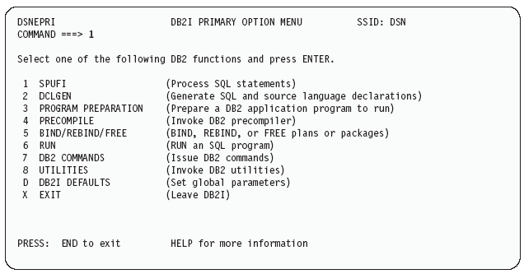
DB2I SPUFI Panel

Slide 17
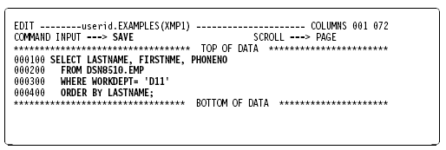
The SPUFI edit panel: After entering an SQL statement

Slide 18
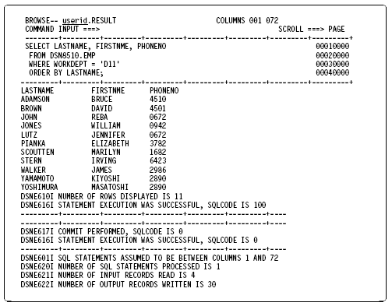
SPUFI Result Dataset from previous SQL

Slide 19
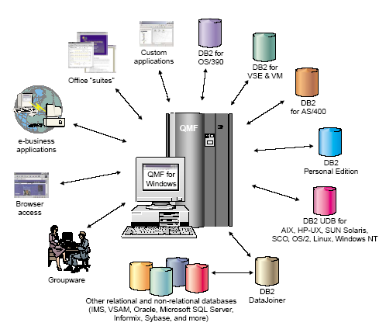
Query Management Facility

Slide 20
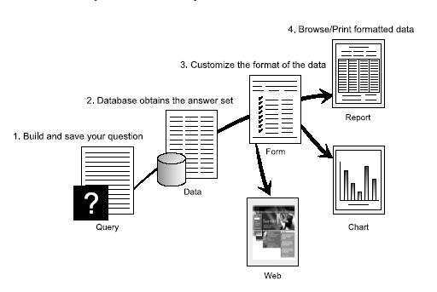
QMF provides results in 4 easy steps

Slide 21
Relational DBMS: Codds relational principles
Primary key
Referential Integrity
Easy to use query language
Nulls
Normalization/Denormalization
  1NF: structure of a table
  2NF: 1-to-1
  3NF: 1-to-many relationships
  4NF, 5NF: many-to-many relationships

Slide 22
Relational DBMS: data structures and SQL
Data Structures
Databases
Tables : column, row and value
Indexes
Keys
  Primary Key – only one because it defines the entity (i.e. Lastname)
  Unique Key – another key also used for access (i.e. SSN)
  Foreign Key – used for referential integrity between keys of different tables
SQL: High level language for relational structures
DML: SELECT, UPDATE, INSERT, DELETE
DDL: CREATE, ALTER, DROP
DCL: GRANT, REVOKE

Slide 23
A database comparison:
IMS:
  Data is relatively static
  Navigational : need to know the structure to get to the right data
DB2:
  Changeable info
  Change in structure : no impact on existing application
  Non-Navigational : no need to know the structure to get to the right data (just tablename and columnname(s))

Slide 24
Summary
Screenshot 2
Interaction with the computer happens online through the help of a transaction manager.
Many transaction managers and database managers exist, but their principles are similar.
Data can be stored in a flat file, but this can result in duplication or inconsistent data. It is better to create central databases, which can be accessed (reading and changing) from different places. [pnn4’
The handling of consistency, security, etc. is done by the database management system.

Slide 25
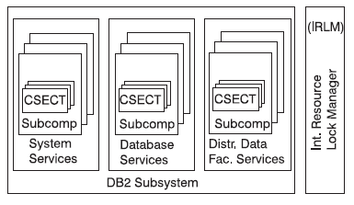
Elements of DB2
Data Structures – used to organize user data
VIEW
TABLESPACE
INDEXSPACE
STORAGE GROUP
System Structures – controlled by DB2
DB2 is a multi-address space subsystem requiring
a minimal of three address spaces
System Services
Database Services
Lock Manager Services (IRLM)
Note: Distributed Data Facility (DDF) is used to
communicate with other DB2 Subsystems
Address spaces

Slide 26
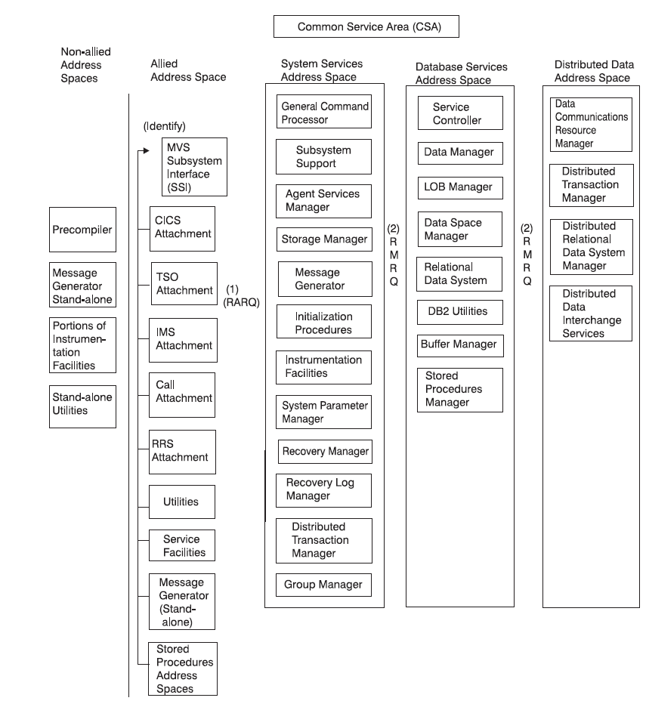
Address Spaces and Component Interfaces

Slide 27
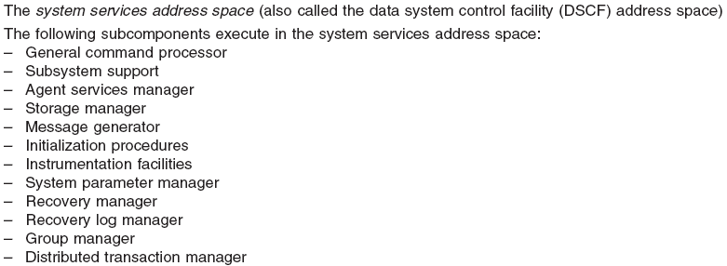
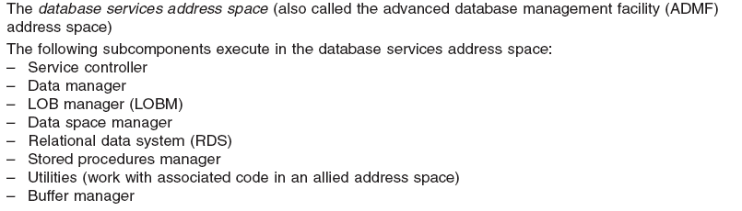
Basic Functions of each Service 1 of 3

Slide 28
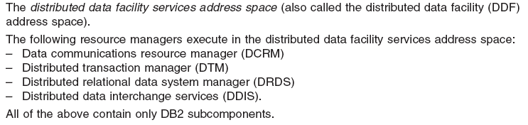
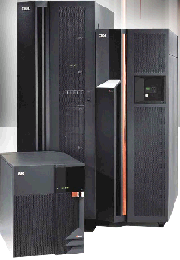
Basic Functions of each Service 2 of 3
DB2
Sys A
DB2
Sys B
DDF
VTAM Open ACB

Slide 29
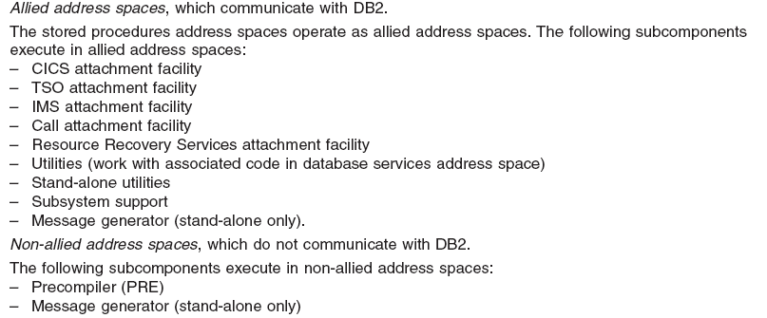
Basic Functions of each Service 3 of 3

Slide 30
DB2 Design Concepts
Resource Managers (RMID)
- Software constructs responsible for managing a particular resource
i.e. DASD, Main Storage, System Service (RDS)
DB2 tasks and Agents
- Subcomponents that run inside the Allied Address Space (ie. Attachment Facilities)
having task structures dictated by their particular function
* Allied Agents (originating in Allied address space)
* System Agents (work requests internal to DB2)
Resource Locking
- Latching: Used for short term serialization of internal DB2 resources performed
by agent services manager
(i.e. storage or control blocks)
- Locking: The Lock Manager (IRLM) used to protect sections of a database
(i.e. P-Locks / L-Locks)

Slide 31
How users communicate with DB2
Attachment Facilities
* CICS Attachment facility (CA)
* Call Attachment Facility (CAF)
* IMS Attachment Facility (IA)
* TSO Attachment Facility (TA)
* Recoverable Resource Manager Services attachment facility (RRSAF)
Note: In a data sharing environment, each DB2 subsystem that is a member of the
data sharing group can run on a different MVS system in the sysplex.
BUT, the DB2 attachment interfaces only attach to a DB2 subsystem running
on the same MVS system as the application.
i.e.
Local
CICS
i.e.
Local
IMS
DB2
Sys A
DB2
Sys B
DDF

Slide 32
DB2 Connection Process
Levels of authorization (identity)
- MVS Subsystem Interface Facility (RACF)
- Program Call (PC) Linkages
Sign On for CICS or IMS user connection only
- Authorization Exit Routine
N/A to TSO
- able to access DB2 resources
Thread Creation (control structure that connects an agent to
a DB2 resource)
- Application Plan (or Plan)
Data Base request Module (DBRM)
- Application Package (subset of a plan)

Slide 33
System Structure
DB2 Catalog
The DB2 catalog consists of tables of data about everything
defined to the DB2 system. The DB2 catalog is contained in
system database DSNDB06.
To illustrate the use of the catalog, here is a brief description of some of what
happens when the employee table is created:
* To record the name of the structure, its owner, its creator, its type (alias, table,
or view), the name of its table space, and the name of its database, DB2
inserts a row into the catalog table SYSIBM.SYSTABLES.
* To record the name of the table to which the column belongs, its length, its
data type, and its sequence number in the table, DB2 inserts rows into
SYSIBM.SYSCOLUMNS for each column of the table.
* To increase by one the number of tables in the table space DSN8S51E, DB2
updates the row in the catalog table SYSIBM.SYSTABLESPACE.
* To record that the owner (DSN8510) of the table has all privileges on the table,
DB2 inserts a row into table SYSIBM.SYSTABAUTH.
Because the catalog consists of DB2 tables in a DB2 database, you can use SQL
statements to retrieve information from it.

Slide 34
System Structure
DB2 Directory
The DB2 directory contains information required to start DB2, and DB2
uses the directory during normal operation. You cannot access the
directory using SQL. The structures in the directory are not described
in the DB2 catalog.
The directory consists of a set of DB2 tables stored in five table spaces
in system database DSNDB01. Each of the following table spaces
is contained in a VSAM linear data set:
1. SCT02 is the skeleton cursor table space (SKCT).
2. SPT01 is the skeleton package table space.
3. SYSLGRNX is the log range table space.
4. SYSUTILX is the system utilities table space.
5. DBD01 is the database descriptor (DBD) table space.

Slide 35
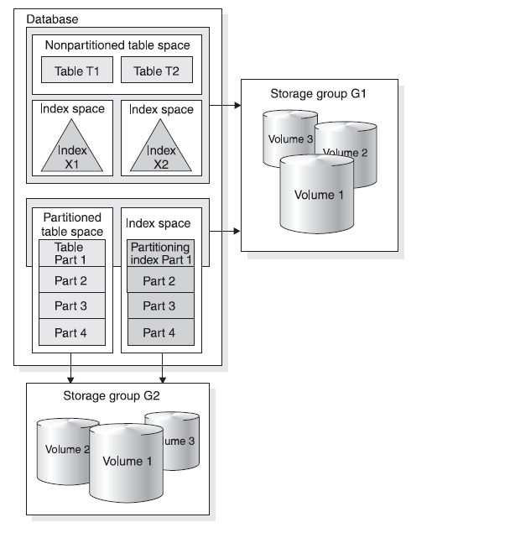
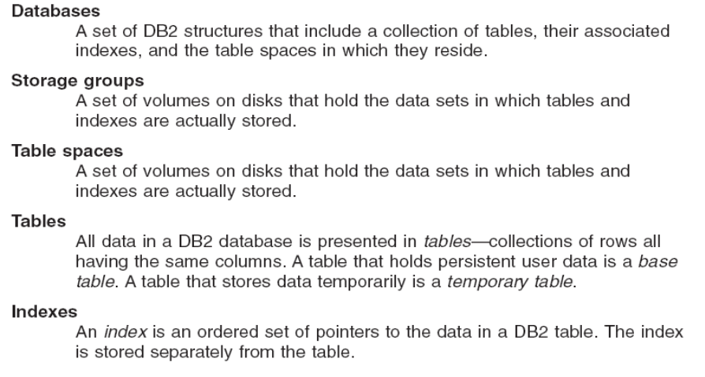
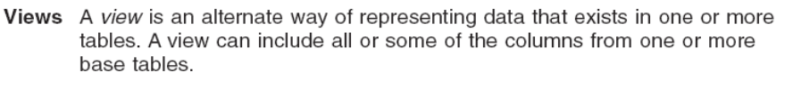
DB2 Hierarchy Structure

Slide 36
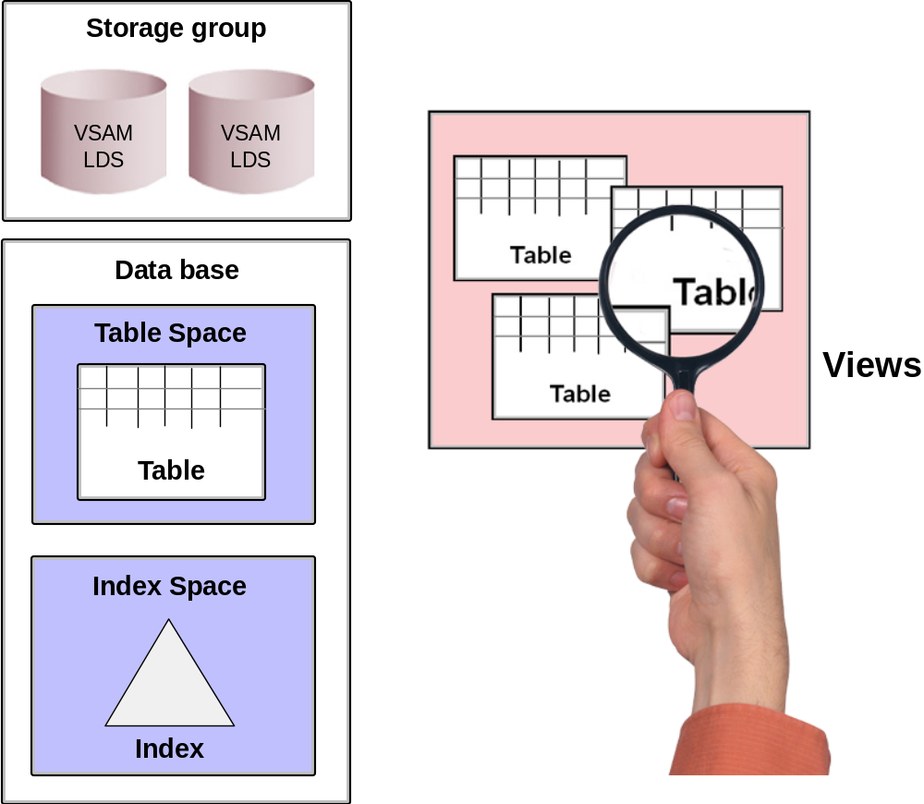
DB2 Concepts: Data Structures

Slide 37
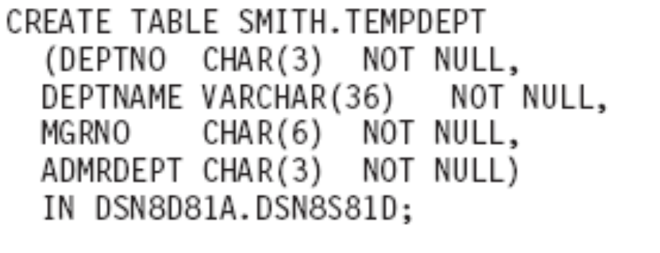
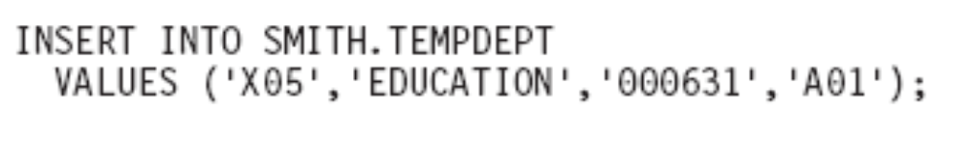
DB2 Table Create and inserting a row (record)

Slide 38
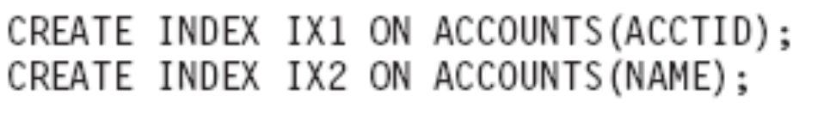
Creating a primary key (index)

Slide 39
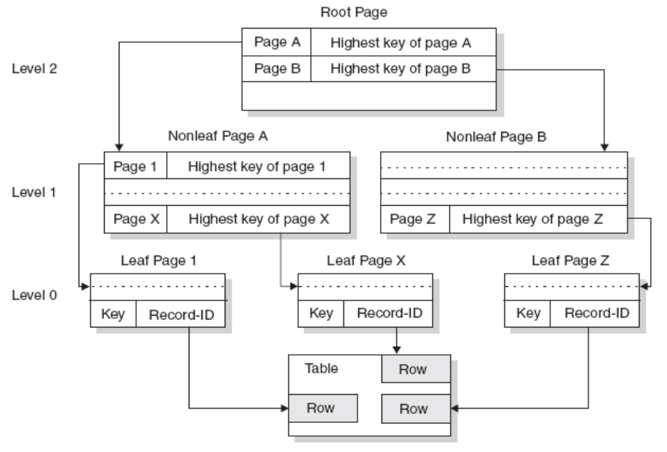
Sample of index set and pointers

Slide 40
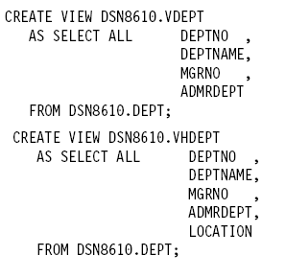
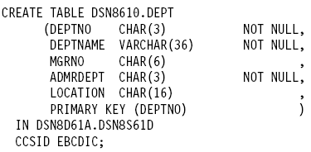
Sample DDL for a DB2 Table/View
Table
VIEW

Slide 41
Schema structures
User-defined Data Type (UDT)
User-defined Function (UDF)
Triggers
Large Object (LOB)
Stored Procedure

Slide 42
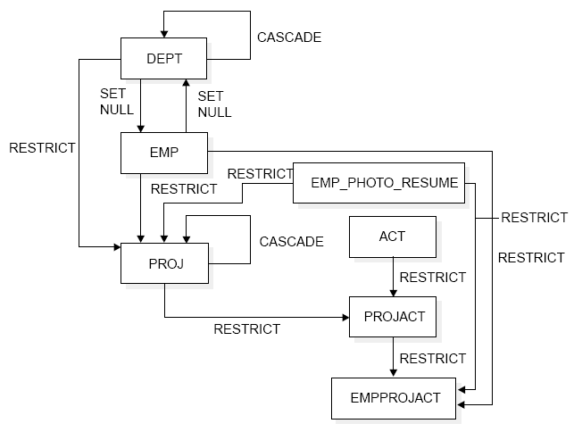
Referential Integrity defining table relationships

Slide 43
System Structure
Catalog & Directory: stores ALL DB2 information
Buffer Pool
Active and Archive Logs
Bootstrap data set (BSDS)

Slide 44
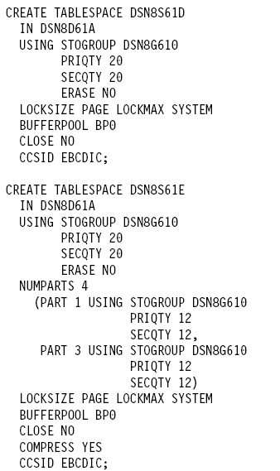

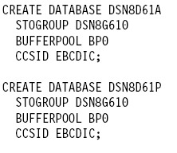
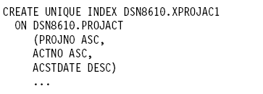
Examples of other Data Definition Language (DDL)

Slide 45
DB2 for z/OS Architecture
DB2 Address Spaces
  System Service address space (SSAS)
  Database Service address space (DBAS)
  Internal Resource Lock Manager (IRLM)
DB2 Attachment Facilities
  CICS
  IMS
  TSO

Slide 46
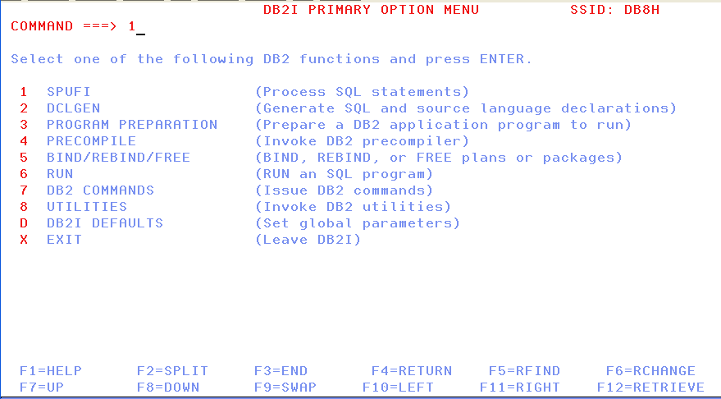
Invoke SQL on z/OS: SPUFI
First you need to create the output file (if not existing)
Select option 1 to enter SPUFI

Slide 47
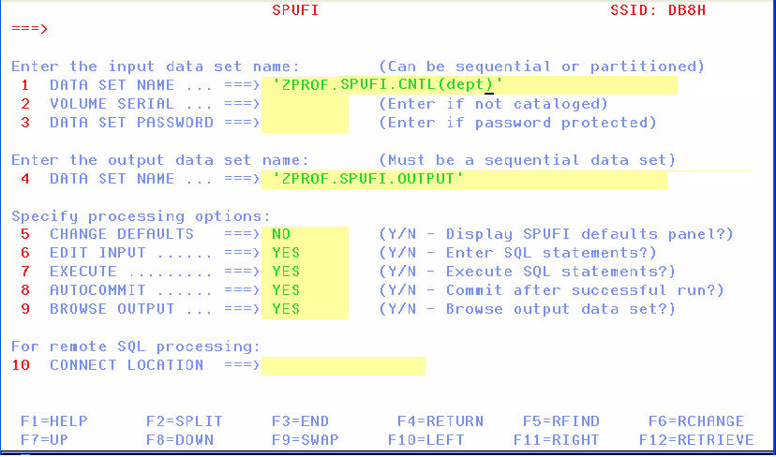
Invoke SQL on z/OS: SPUFI (CONT…)
Enter the input and output dataset, if they are not yet in place.
Change the member of the PDS, if you want to enter a new SQL
Defaults are set to NO from YES.

Slide 48
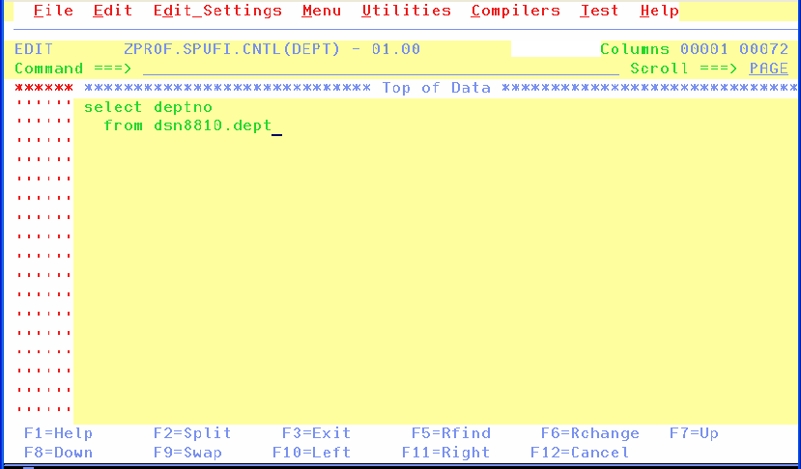
Invoke SQL on z/OS: SPUFI (CONT…)
Enter the SQL statement you want to execute.
Press F3 to return to the previous screen (to execute the SQL).

Slide 49
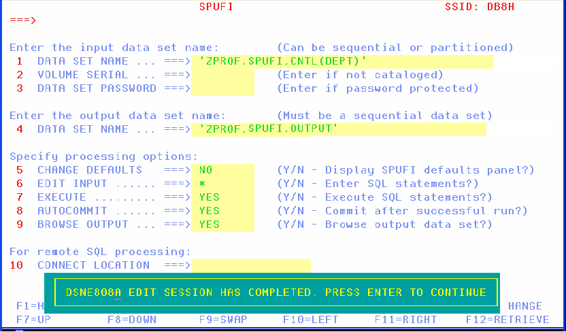
Invoke SQL on z/OS: SPUFI (CONT…)
When you get back to this screen, the “edit input” is put to “*”.
Press ENTER to execute the SQL and to see the output.

Slide 50
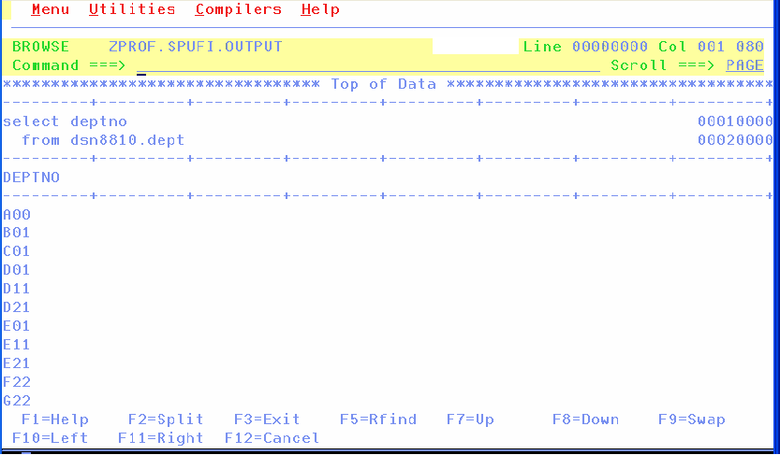
Invoke SQL on z/OS: SPUFI (CONT…)
F8 brings the rest of the results on your screen

Slide 51
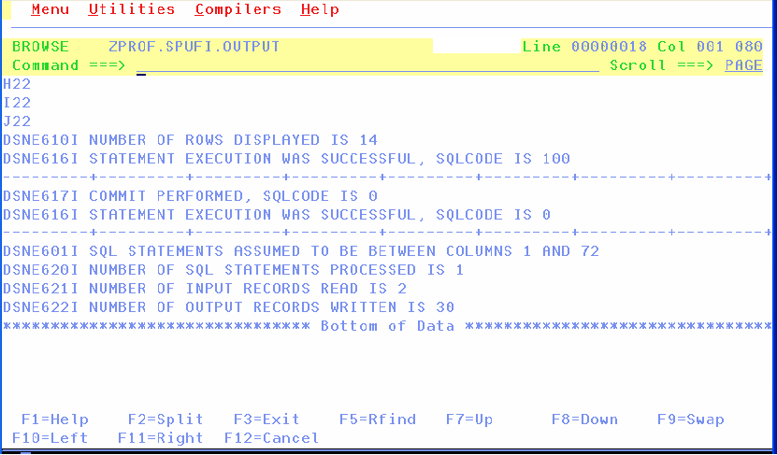
Invoke SQL on z/OS: SPUFI (CONT…)

Slide 52
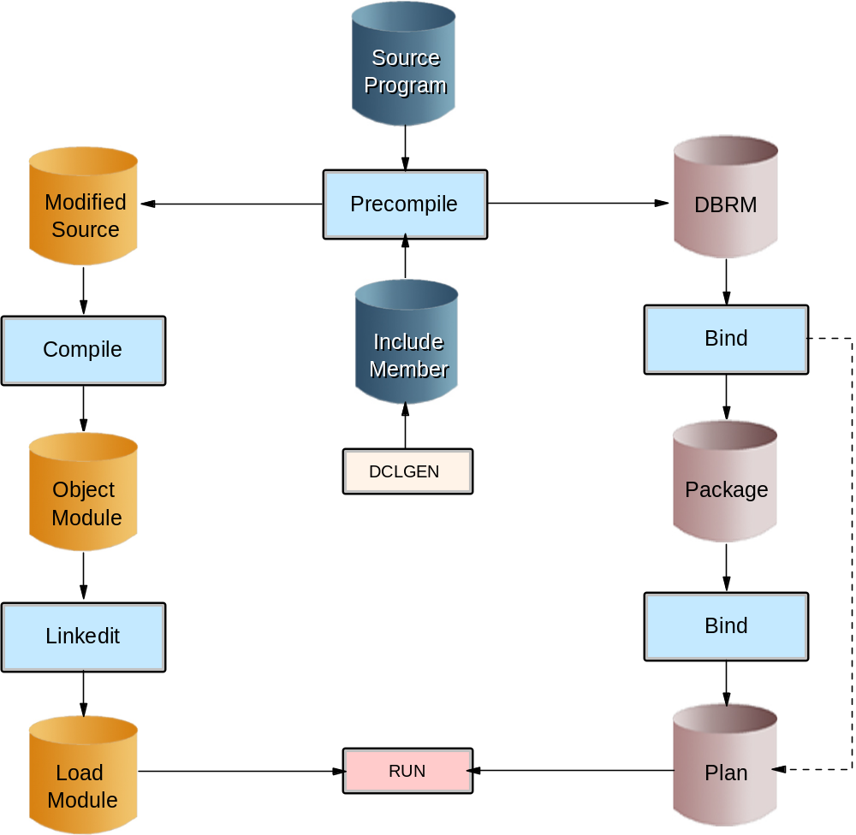
Application Programming: the flow

Slide 53
Get the access path: EXPLAIN
EXPLAIN ALL SET QUERYNO = 1
SELECT EMPNO, LASTNAME
FROM EMP
WHERE LASTNAME = 'MILLER';
The query is NOT executed
The access path is placed in userid.PLAN_TABLE, if it exists

Slide 54
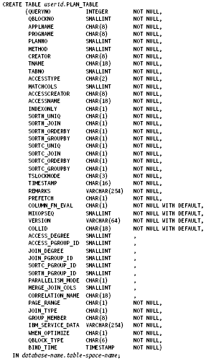
Creating an Explain Table
Don't worry ....you
don't have to type up
this entire DDL ...there
is a sample table for
your use
access path information

Slide 55
Managing DB2: System Administration (SYSADM)
Installation
System Object Management
System and Disaster Recovery
Monitoring System Performance
“Contains all privileges for the entire DB2 Subsystem”

Slide 56
Managing DB2: Database Administration (DBADM)
Creation & Management of DB2 Objects for a particular DB2 Database
Execution of Utilities:
  Data Organization
  Backup & recovery
  Data Consistency
Commands

Slide 57
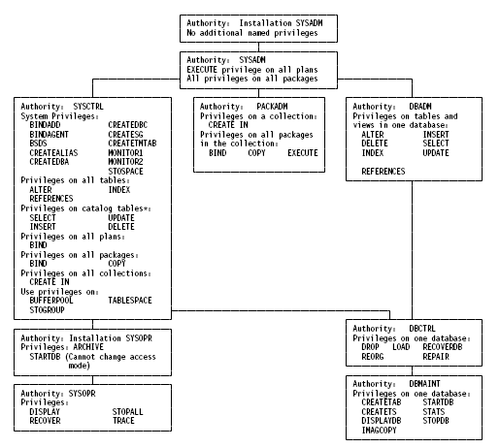
Administrative Authorities
SYSADM
SYSCTRL
DBADM
DBCTRL
SYSOPR
DBMAINT

Slide 58
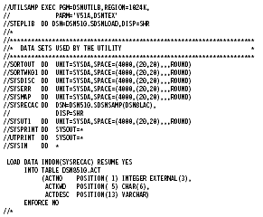
Example of LOAD Utility

Slide 59
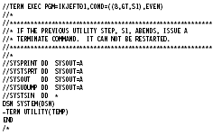
DB2 uses TSO IKJEFT01
Note: This is the TSO Background Program
This example we are terminating a suspended utility job

Slide 60
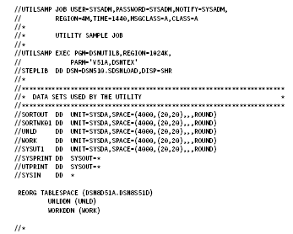
Reorg Utility Example

Slide 61
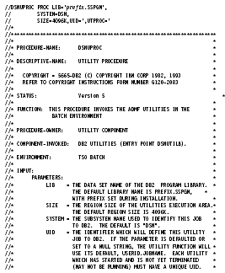
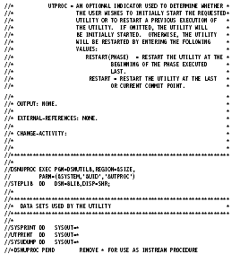
DSNUPROC – creating JCL yourself

Slide 62
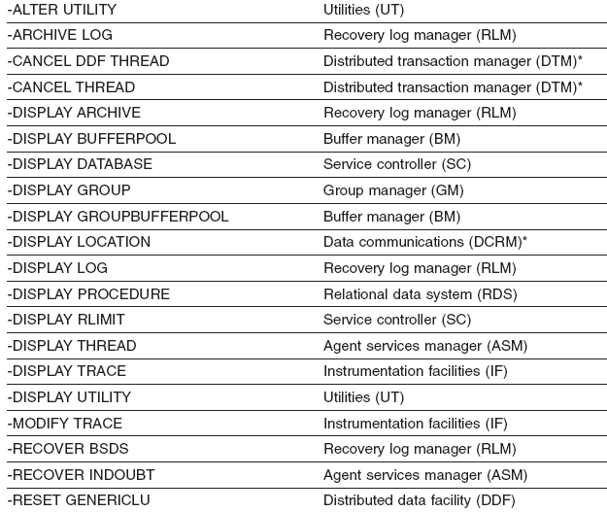
DB2 Commands
Part 1 of 2

Slide 63
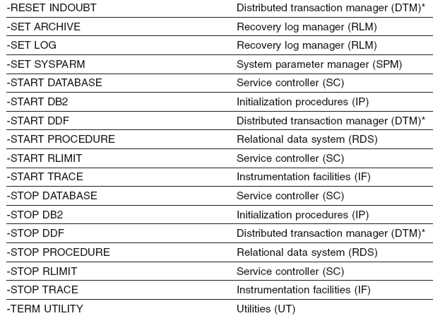
DB2 Commands
Part 2 of 2

Slide 64
I M S
Information Management System

Slide 65
Functions of the IMS database manager
A DBMS provides:
  Multiple-user access to a single copy of data
  Integrity for all updates
  Minimal hardware and OS access method dependencies
  Reduced data redundancy

Slide 66
Implementation of IMS Databases
Depending on user' requirements
Technologies :
  IMS DB or DL/I or DL1 or Full Function Database
  IMS DEDB or Data Entry DB or Fast Path Database
  IMS Main storage database (MSDB)
  IBM DB2
Database Recovery Control (DBRC)

Slide 67
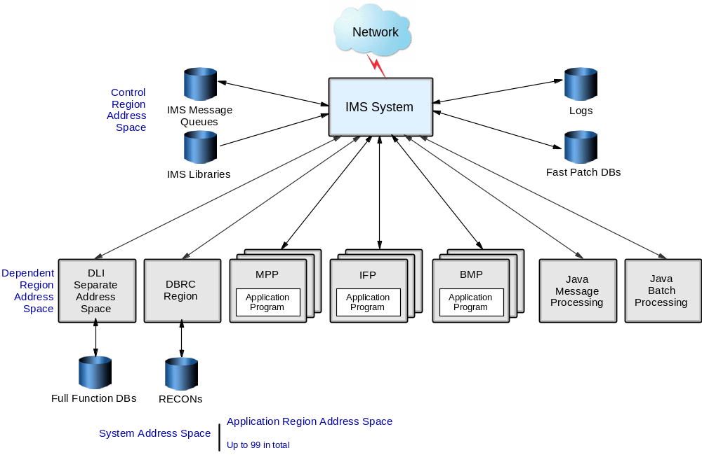
Structure of IMS DB Subsystem

Slide 68
Databases used by IMS: Database basics
Access paths
Normalization within IMS
  Unique entities
  1 occurrence only
  No many-to-many relationships

Slide 69

Databases used by IMS: DB Model
Sequence to access the segments

Slide 70
Databases used by IMS: DB model
Additional access paths to segments
  Logical relationships
  Secondary indices

Slide 71
Application programming overview
Program is subroutine of IMS region controller
  Needs a program specification block (PSB)
  Uses services:
    Send/receive message from terminals
    Access db
    Issue IMS commands
    Issue IMS service calls
      e.g. Checkpoint calls, Sync call

Slide 72

Program Structure

Slide 73

IMS & the World Wide Web
Message flow in IMS transaction

Slide 74

IMS & the World Wide Web
Message flow between Web Browser & Web Server

Slide 75

IMS & the World Wide Web
Message flow IMS transaction & Web Server CGI Programs

Slide 76
Summary
The relational database is the predominant approach to data organization in today's business world.
IBM’s DB2 implements such relational principles as primary keys, referential integrity, a language to access the database (SQL), nulls, and normalized design.
In a relational database, the most fundamental structure is the table with columns and rows.

Slide 77
Summary (continued)
The only way to access the data in DB2 databases is with SQL.
On the mainframe, SPUFI is a tool used to enter SQL statements.
The DBRM performs a bind process that determines the access path and stores this executable SQL code in a package.
SQL can handle both static and dynamic statements, and EXPLAIN can be used to find out what access path the optimizer chose for the SQL.

